Slide 1
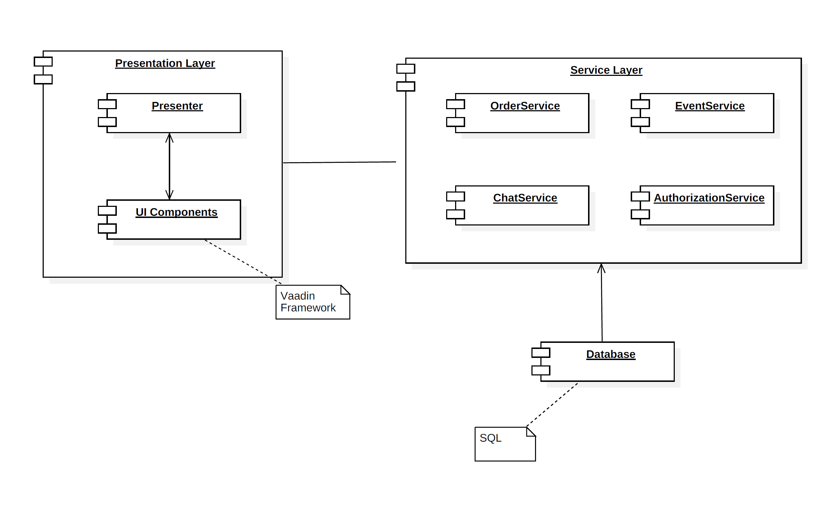
Component Diagram

Slide 2
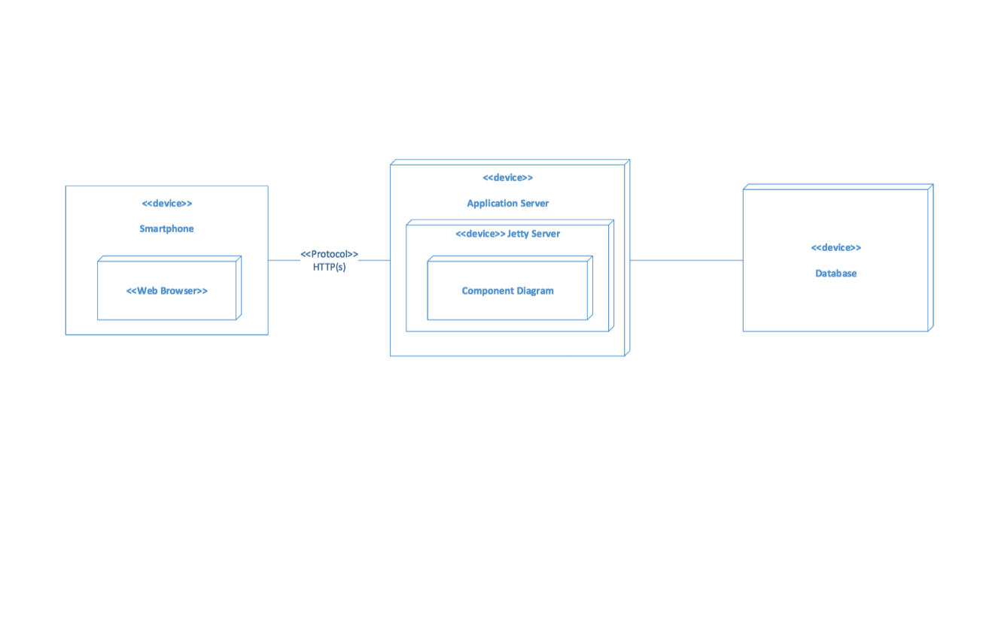
Deployment Diagram

Slide 3
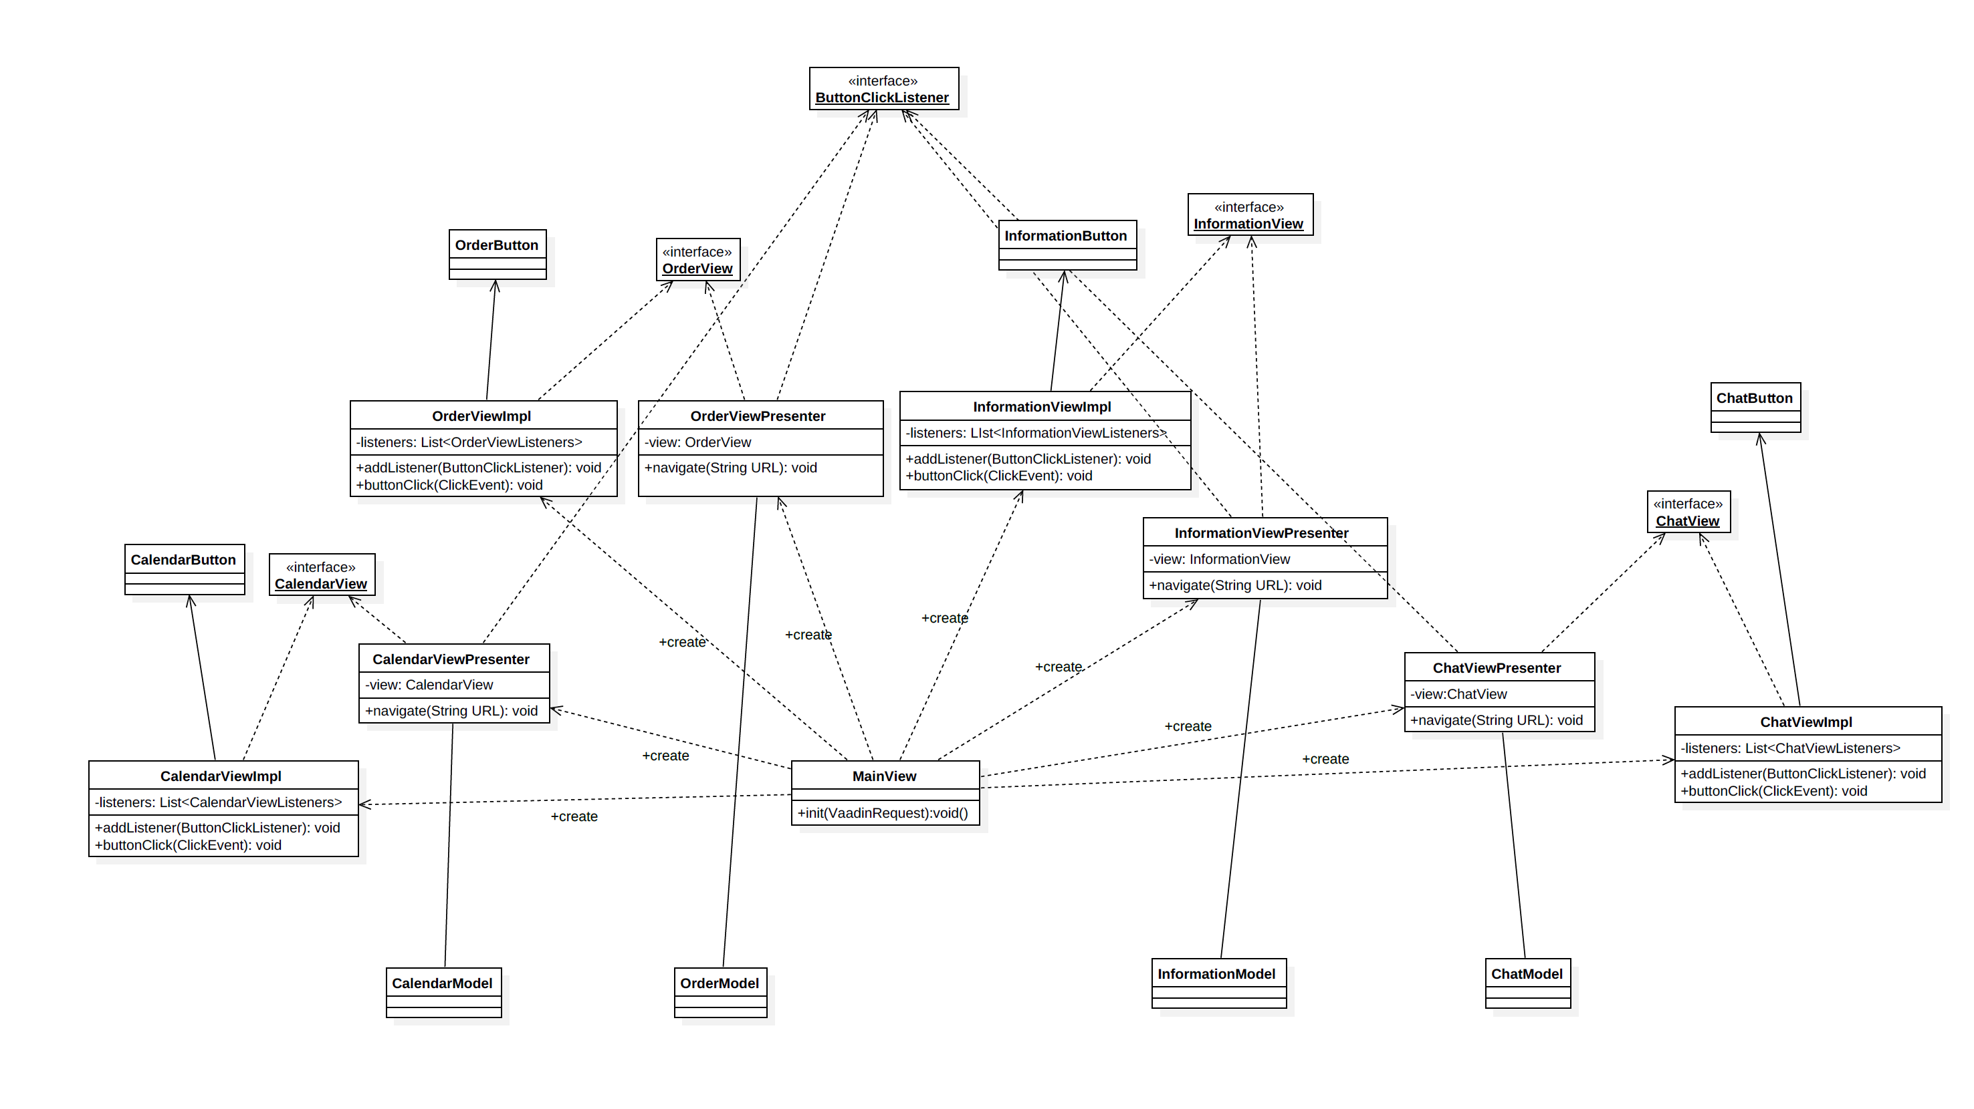
Class Diagram

Slide 4
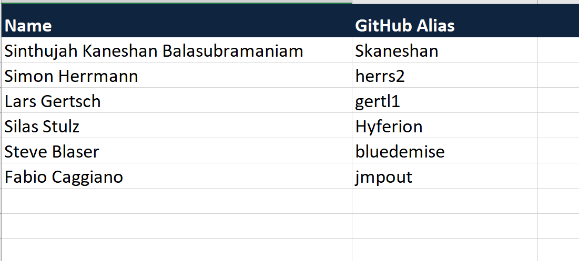
Project Team

Slide 5

Product Backlog

Slide 6

Sprint Backlog

